Slide 1

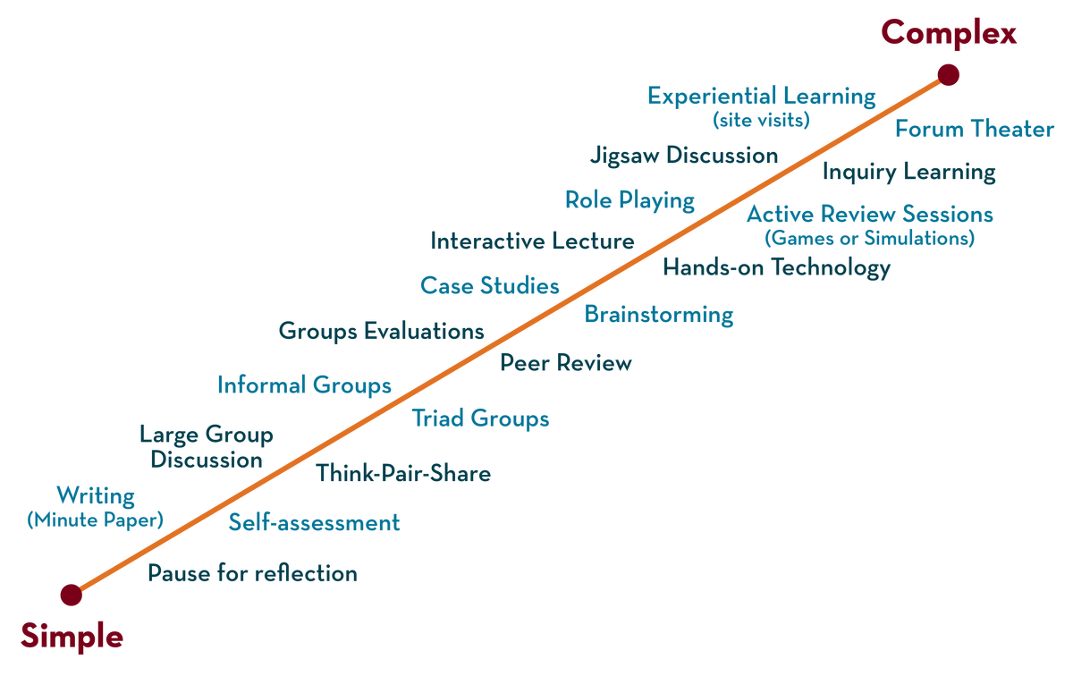
DEPARTMENT OF CSE , CSIT & AI&Ds
COURSE NAME – adaptive Software Engineering
COURSE CODE – 23CI2001
Topic:
Introduction to SAFe
&
SAFe Methodology
Session - 15

Slide 2


INSTRUCTIONAL OBJECTIVES
This Session is designed to:
Define SAFe
Describe foundations of SAFe
List out the uses of SAFe
Describe SAFe core values
LEARNING OUTCOMES
At the end of this session, you should be able to:
Define SAFe
Describe the foundations of SAFe
Summarize SAFe principles

Slide 3
agenda
SESSION DESCRIPTION
What is Scaled Agile Framework (SAFe)
Why to use Agile Framework
When to Use Scaled Agile Framework
Foundations of Scaled Agile Framework

Slide 4
What is Scaled Agile Framework (SAFe)
The Scaled Agile Framework® (SAFe®) is a set of organizational and work flow patterns for implementing agile practices at an enterprise scale.
The framework is a body of knowledge that includes structured guidance on roles and responsibilities, how to plan and manage the work, and values to uphold.

Slide 5
SESSION DESCRIPTION (Cont..)
Scaled Agile Framework (SAFe):
Scaled Agile Framework SAFe, is an online knowledge base that allows you to apply lean-agile practices at the enterprise level. It provides a simple, lightweight experience for the software development team.
The whole framework is divided into three segments: Team, Program and Portfolio.
SAFe allows team for,
Implementing Lean-Agile software and systems in enterprise level
It's based on Lean and Agile principles.
It gives detailed guidance for work at the enterprise Portfolio, Value Stream, Program, and Team.
It's designed to meet the needs of all stakeholders within an organization.

Slide 6
SESSION DESCRIPTION (Cont..)
What is the difference between Agile and Lean Agile?
The difference is that in Lean thinking, teams increase speed by managing flow (usually by limiting work-in-progress), whereas in Agile, teams emphasize small batch sizes to deliver quickly (often in sprints).

Slide 7
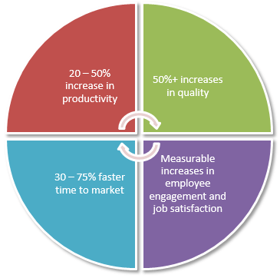
SESSION DESCRIPTION (Cont..)
Why to use Agile Framework:
It is simpler and lighter in weight, yet it expands to handle the needs of large value streams and complex system development. By implementing an Agile Framework, you will have following benefits,
•Productivity increased by 20 - 50%
•Quality increased more than 50%
•Time to Market is faster than 30 -75%
•Increased employee engagement and job satisfaction.

Slide 8
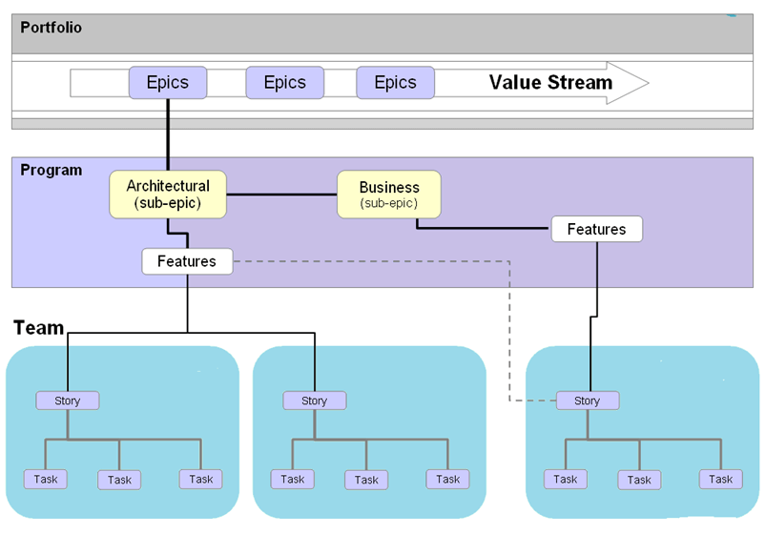
SESSION DESCRIPTION (Cont..)
Agile Process Works:
Fig: Scaled Agile Framework Architecture

Slide 9
SESSION DESCRIPTION (Cont..)
Epics are a large body of work, which is further broken down into a number of smaller stories or sub-epics.
These sub-epics are allocated to the team as a story.
Each team then work on these stories or software features accordingly.

Slide 10
When to Use Scaled Agile Framework
When a team is interested to implement an agile approach consistently across larger, multi-team programs and portfolios.
When multiple teams are running their own way of Agile implementation but regularly facing obstacles, delays, and failures.
When teams want to work independently.
When you want to scale Agile across the organization but not sure what new roles may be needed or what existing roles (i.e., management) need to change and how.
When you have attempted to scale the Agile across your organization but struggling in alignment to achieve uniform or consistent strategy across business departments from portfolio to program and team levels.
When an organization needs to improve its product development lead time and want to know how other companies have succeeded in scaling Agile with SAFe.

Slide 11
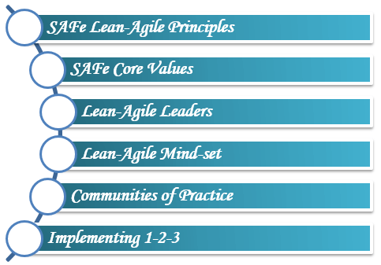
Foundations of Scaled Agile Framework
SESSION DESCRIPTION (Cont..)

Slide 12
SAFe Lean-Agile Principles
SESSION DESCRIPTION (Cont..)
•Take an economic view
• Apply systems thinking
• Assume variability; preserve options
• Build incrementally with fast, integrated learning cycles
• Base milestones on an objective evaluation of working systems
• Visualize and limit WIP, reduce batch sizes and manage queue lengths
• Apply cadence ( sequence of events), synchronize with cross-domain planning
• Unlock the intrinsic (decentralized evolution) motivation of knowledge workers
• Decentralize decision-making

Slide 13
SESSION DESCRIPTION (Cont..)
The SAFe agile is based on these four values.
Alignment: Starts at Strategic Themes in Portfolio Backlog and Moves down to Vision and Roadmap of Program Backlogs and then Moves to the Team Backlogs.
Built-in Quality : It ensures that every incremental delivery reflects the quality standards.
Transparency:
Transparency is the enabler for trust.
SAFe helps the enterprise to achieve transparency at all levels- Executives, Portfolio Managers, and other stakeholders.
Program Execution: SAFe places great focus on working systems and resultant business outcomes.

Slide 14
Lean Agile Leaders
SESSION DESCRIPTION contd..
As an enabler for the teams, the ultimate responsibility is adoption, success and ongoing improvement of Lean-Agile developments. For the change and continuous improvement, leaders must be trained.
Principles of these Lean-Agile Leaders
• Lead the Change
• Know the Way; Emphasize Lifelong Learning
• Develop People
• Inspire and Align with Mission; Minimize Constraints
• Decentralize Decision-Making
• Unlock the Intrinsic Motivation of Knowledge Workers

Slide 15
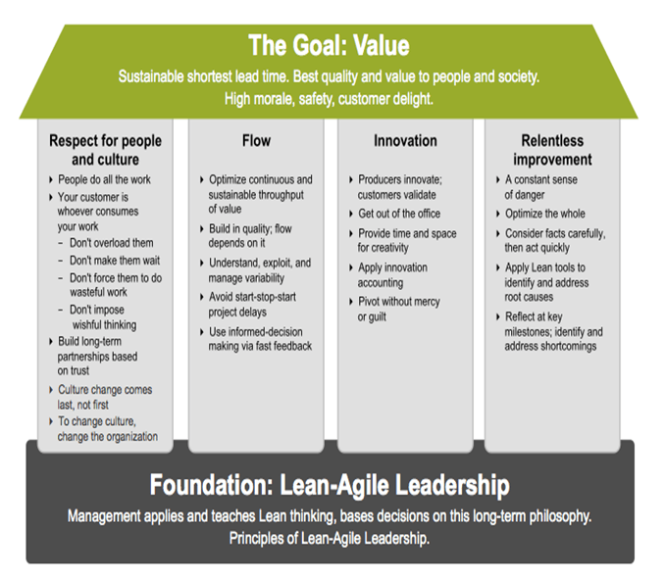
Lean Agile Leaders
SESSION DESCRIPTION (Cont..)

Slide 16
Lean Agile Mind-Set
SESSION DESCRIPTION (Cont..)
Lean-Agile mindset is represented in two things:
The SAFe House of Lean
SAFe is derived from Lean manufacturing principles and practices. Based on these factors SAFe presents the "SAFe House of Lean". It is inspired by "house" of lean Toyota.
The Goal of lean is unbeatable: To deliver maximum customer value in the shortest lead time with the highest possible quality to customer
Agile Manifesto
We are uncovering better ways of developing software by doing it and helping others do it. Through this work we have come to value.

Slide 17
Objective
SAFe Methodology
SAFe provides a set of best practices, principles, and guidelines for implementing Agile practices at the enterprise level. It includes several layers, such as portfolio, program, and team, which are designed to provide alignment, synchronization, and visibility across all levels of the organization

Slide 18
SESSION INTRODUCTION
SAFe is built on nine key principles derived from existing Lean and agile principles:
Take an economic view to allow for optimal lead time while providing the best quality and value.
Implement systems thinking into all facets of development.
Assume market and technical variability by preserving choices and encouraging innovation.
Build incrementally with fast, integrated learning cycles that allow customer feedback and reduce risks.

Slide 19
What safe provides
SAFe provides a set of best practices, principles, and guidelines for implementing Agile practices at the enterprise level. It includes several layers, such as portfolio, program, and team, which are designed to provide alignment, synchronization, and visibility across all levels of the organization

Slide 20
Scaled frame work
The Scaled Agile Framework (SAFe) is a widely used framework for implementing Agile at scale. It is a proven, publicly available framework that can help organizations align their business goals with their software development processes. SAFe provides a set of guidelines and practices that can be used to manage and coordinate large-scale Agile projects

Slide 21
principles
Take an economic view: Organizations need to understand the economic implications of their decisions and actions. They must strive to deliver value to their customers in the most efficient way possible
Apply systems thinking: A system is more than the sum of its parts. Organizations must consider the interdependence of their people, processes, and technology to create a high-performing system that delivers value
Build incrementally with fast, integrated learning cycles: Organizations must build their solutions incrementally and iteratively. They must also have fast, integrated learning cycles to gather feedback and improve continuously.

Slide 22
base mile stones
Base milestones on objective evaluation of working systems: Organizations must base their milestones on objective criteria, such as the working functionality of the system, rather than subjective opinions
Visualize and limit work-in-progress, reduce batch sizes, and manage queue lengths: Organizations must visualize their work and limit work-in-progress to reduce batch sizes and manage queue lengths. This helps to improve flow and reduce cycle times
Apply cadence, synchronize with cross-domain planning: Organizations must apply cadence to their work to create a predictable and reliable delivery rhythm. They must also synchronize their work across different domains to ensure alignment and coordination

Slide 23
Decentralized decision making
Unlock the intrinsic motivation of knowledge workers: Organizations must recognize that knowledge workers are motivated by autonomy, mastery, and purpose. They must create an environment that enables them to do their best work
Decentralize decision-making: Organizations must decentralize decision-making to the people closest to the work. This enables them to make informed decisions and respond quickly to changing circumstances
These principles provide a common language and set of values for all individuals and teams involved in SAFe. They guide decision-making and help organizations to create a culture of continuous improvement and learning

Slide 24
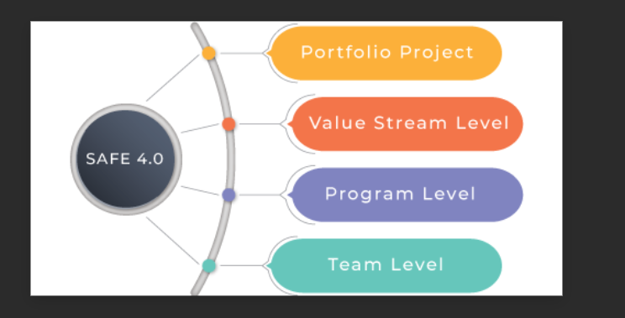
safe frame work

Slide 25
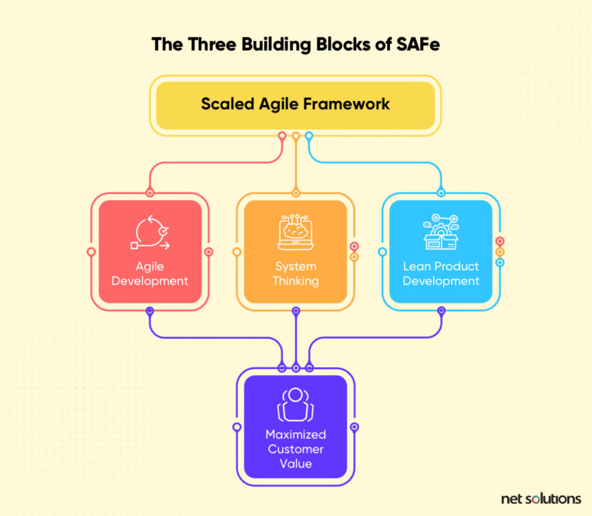
process

Slide 26
SAFe methodology can be applied in a variety of applications and scenarios, including
Large-Scale Software Development: SAFe is particularly useful for large-scale software development efforts that involve multiple teams, departments, and stakeholders. By providing a structured framework for collaboration and communication, SAFe helps to ensure that everyone is aligned on the project goals and working together towards a common objective
Enterprise-wide Agile Transformation: SAFe can also be used to drive enterprise-wide agile transformations. By providing a roadmap for agile adoption, SAFe helps to ensure that the transformation is planned and executed in a systematic and effective manner, with buy-in from all stakeholders

Slide 27
continuation
Cross-functional Teams: SAFe is ideal for cross-functional teams that require a high degree of collaboration and coordination. By providing a structured approach to planning and execution, SAFe helps to ensure that all team members are aligned on the project goals and working towards a common objective
Product Development: SAFe is well-suited for product development efforts, where multiple teams are involved in developing and delivering a product. By providing a framework for continuous delivery, SAFe helps to ensure that the product is delivered on-time and on-budget, with high quality

Slide 28
CONCLUSION
Overall, SAFe methodology is a versatile framework that can be applied in a wide range of applications and scenarios. Its structured approach to collaboration, planning, and execution makes it an ideal choice for large-scale software development, enterprise-wide agile transformations, cross-functional teams, product development, and agile project management

Slide 29
SELF-ASSESSMENT QUESTIONS
What is Scaled Agile Framework (SAFe)
Why to use Agile Framework
When to Use Scaled Agile Framework
Explain Foundations of Scaled Agile Framework

Slide 30
REFERENCES FOR FURTHER LEARNING OF THE SESSION
TEXT BOOKS:
1 . Roger S.Pressman, “Software Engineering – A Practitioner’s Approach” 7th Edition, Mc Graw Hill,(2014).
2. Ian Sommerville, “Software Engineering”, Tenth Edition, Pearson Education, (2015).
Reference Book
Agile and Iterative Development: A Manager's Guide, Craig Larman, Addison-Wesley

Slide 31
WEB REFEReNCES/MOOCS:
:
https://www.digite.com/kanban/what-is-kanban/
http://www.scaledagileframework.com
https://www.guru99.com/test-driven-development.html
https://junit.org/junit5/

Slide 32
THANK YOU
Team –ADAPTIVE SOFTWARE ENGINEERING

